Slide 1
Laptops for Front-End Developers
Presentation by: Diana Jean C. Tuquib
Notes:
Good afternoon everyone! My name is Diana Tuquib. I will be giving a comparative report on laptops for front-end developers.
Before I begin, I just want to make a quick technical check. Please let me know if you have trouble hearing me or seeing the presentation.
Choosing the right laptop for programmers can sometimes be challenging due to the overwhelming number of options available. Today I will be comparing two of the most recommended laptops to determine which of them is better.

Slide 2
Laptop for Front-End Developers
Background
Definition of Terms
Scope and Limitation
Criteria
Conclusion
Recommendation
References
Notes:
I will begin by giving you a brief overview of what programmers do and why it is important for them to have a good quality laptop.
Next, I will define a few terms that you as laypersons may not have encountered with yet or terms that you may have heard but don’t really know the definition.
I will also lay out the scope and limitation of this report followed by the criteria and the conclusion.
Finally, my recommendation and the references I used.

Slide 3

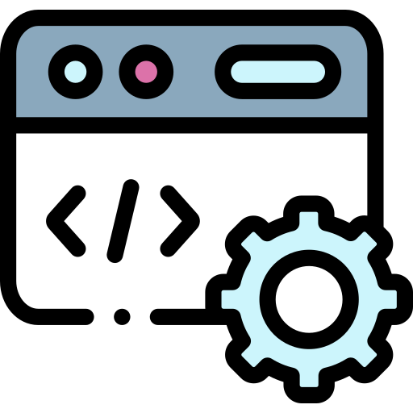
Background
Front-End Development | Back-end Development
Client-side development Layout Colour palette Look and feel | Server-side Development Ease of use Application logic Database management
Notes:
Web or application development can be divided into two: front-end development and back-end development. Front-end developers focus on client-side development. They usually work on the website’s aesthetics [1]. They design the website’s layout, colour palette, and the overall look and feel of the application. Back-end developers, on the other hand, focus on server-side development. They work on the website’s ease of use, application logic design, and database management. [2].
Determining the laptop on which a developer designs a website or application is very crucial. Working on a project using an outdated laptop could delay project development and risk losing important data.
For today, I will only focus on laptops for front-end development. This report aims to dissect and determine which laptop is better for front-end developers.

Slide 4

Definition of Terms
01
Pixel – picture element is the smallest detail in an image [4]
02
Refresh rate – the number of times per second the computer monitor takes to display a new frame [5]
03
Core – part of the computer processor that performs one task at a time [6]
04
Thread – a virtual version of the core that allows the core to perform more than one task at a time [6]
Notes:
Let’s take a look at some of the terms and definition.
(read terms)
Pixel - When you zoom in a picture far enough, you’ll see tiny squares. These squares called pixels. Each pixel holds colour and when put together, can form an image or illustration). The more pixels there are, the clearer and more detailed the images are.
Refresh rate - So if you play an HD video on a low refresh monitor, there’s a chance that you’ll encounter issues. You might see multiple frames at the same time or you’ll see some parts of the frame that aren’t lined up properly.

Slide 5
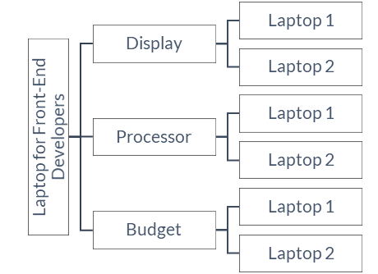
Scope and Limitation
MacBook Pro 16-in vs HP Spectre x360
Specifications directly from the manufacturer’s website only
Max upgrade
Consider only three (3) criteria
1 point for each criterion (total of 3)
Notes:
Next, these are the scope and limitation of my report:
There are many options out there for programmers to choose from. In this report, I will only be comparing two laptops. I’ve chosen to compare these two because they are the ones that were frequently featured in online articles. [7, 8, 9]. It will Apple MacBook Pro 16 inches versus HP Spectre x360.
I will be getting the specifications directly from the manufacturer’s website only. Some parts of the laptop are upgradable. If that upgrade is not on their website, I will not consider that.
Max upgrade - If a certain upgrade is in my list of criteria, I will choose the highest upgrade available. For example, if my criteria includes laptop storage, I will choose the highest storage available.
Next, I have three criteria. There are other features that should be considered when choosing laptops, but I will only be judging them based on three.
I will be treating each criterion equally. The laptop can only have either one point or no point in each round.
Finally, I will be using the comparative analysis format you see on the right side. I will start with the first criterion and compare the two laptops. Then , I will explain the second criterion and compare the two laptops, so on and so forth.
Let’s begin.

Slide 6
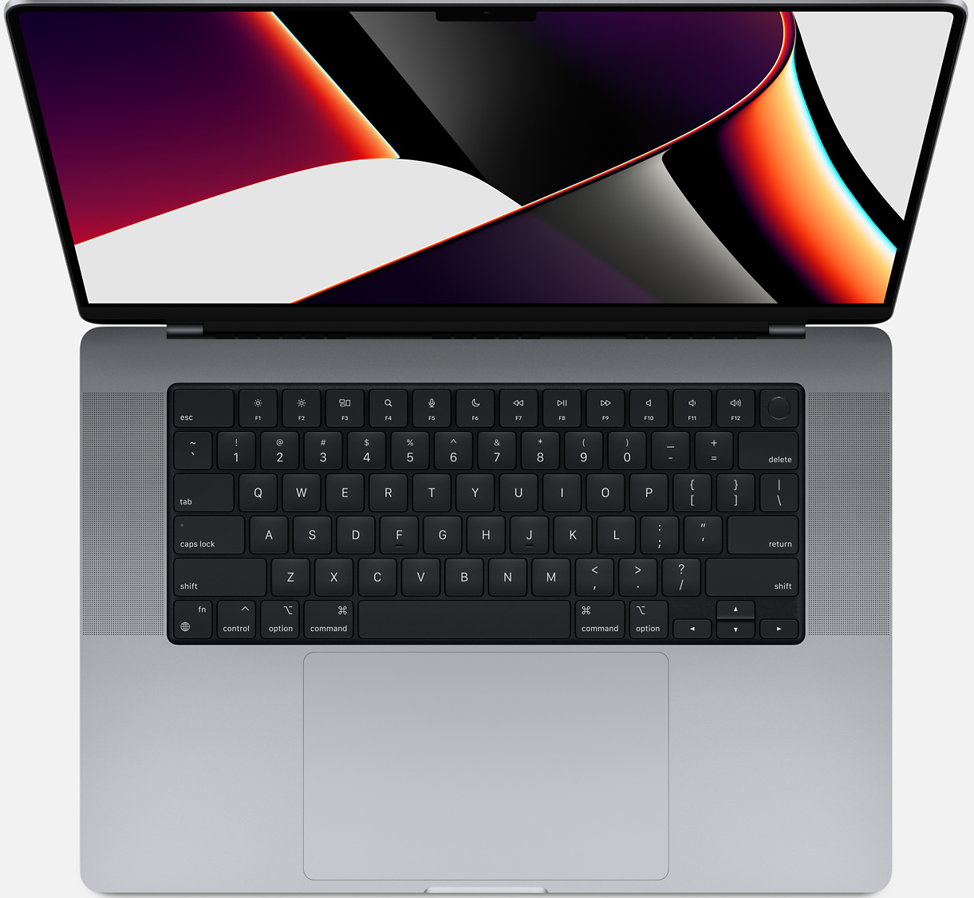
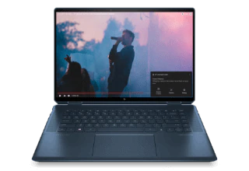
Display
Apple MacBook Pro
Display size: 16.2 in
Display resolution:
3456 x 2234 pixels
Touchscreen: No
Pixels per inch: 254
Refresh rate: 120 Hz
Round 1: HP Spectre x360
HP Spectre x360 Laptop
Display size: 16 inches
Display resolution:
3840 x 2400 pixels
Pixels per inch: 283
Touchscreen: Yes
Refresh rate: 60 Hz
Notes:
The first criterion is the laptop’s display.
Having a laptop with good display features is very important because front-end development heavily focuses on design. Designing an HD application using a low-resolution computer, for example, could be very detrimental to the project because the laptop will not be able to handle the project’s requirements.
These are the display specifications for MacBook Pro and HP Spectre x360.
Skip if overtime: As you can see on the slide, MacBook Pro has a display size of 16.2 inches with a resolution of 3,456 pixels by 2,234 pixels. It has 254 pixels per inch. It doesn’t have a touchscreen feature, but its refresh rate is 120 Hertz [11].
HP Spectre x360, on the other hand, has a display size of 16 inches with a resolution of 3,840 pixels by 2,400 pixels. It has 283 pixels per inch and a touchscreen feature. It also has a refresh rate of 60 Hertz [12].
<click next!!!>
For this criterion, the HP Spectre x360 trumps the MacBook Pro. Even though MacBook Pro has a wider display size and a faster refresh rate, HP Spectre has a higher display resolution and has more pixels per inch. This means that images produced by HP Spectre are clearer than that of the MacBook Pro. On top of that, HP Spectre has a touch screen feature. This is especially helpful for front-end web developers who may also need to sketch or draw to create illustrations or edit images.

Slide 7
Processor
Apple MacBook Pro
Core: 10
Thread: 10
Round 2: Apple MacBook Pro
HP Spectre x360 Laptop
Core: 4
Thread: 8
Notes:
The next criterion is the processor.
The computer’s processor, also called the Central Processing Unit, is responsible for executing all the instructions received from the user, application, or other computers. The processor determines how quickly a computer can store and retrieve data [10].
Working on projects using a computer with a weak processor not only delays the work development but also risks losing progress. This is especially crucial because most applications used by front-end developers, such as Adobe Photoshop and Premiere Pro, require powerful processors. If the computer cannot handle the workload of the application, the computer could crash, and the developer could lose all the unsaved data.
According to their website, MacBook Pro has 10 cores and each core has 10 threads [11]. HP Spectre has 4 cores and each core has 8 threads [12].
<click next!!!>
MacBook Pro has more cores and more threads than HP Spectre, which means that MacBook Pros perform way faster than its HP counterpart. This criterion can be very important to those who require their laptops to multitask.
So far, there’s one point for HP Spectre and one point for MacBook Pro. The tiebreaker will be the next criterion, which is the budget

Slide 8
Budget
Apple MacBook Pro
Approx. US$ 3,499.00
Round 3: HP Spectre x360
HP Spectre x360 Laptop
Approx. US$ 2,369.99
Notes:
It is important to consider the budget when choosing the right laptop for developers. While most office-employed developers are paid well and are provided computers by their employers, there are freelance/self-employed developers who need to provide their own equipment. Some developers who are still starting or are still studying also may not have much to start with.
MacBook Pro with its powerful processor costs US$3,499 [11]. HP Spectre x360 with its impressive display costs US$2,369.99 [12].
<click next!!!>
As a student and a beginner programmer with very limited financial resources, I will give this final round to HP Spectre x360. I’ll be working with a lower processing unit, but I can trade it for a better one after maybe a year or two of working. As a beginner programmer, I will not immediately have big clients with big projects. I think HP’s processor is still a good enough working laptop for starters. Moreover, despite having a lower processor, it still meets the minimum requirements set by Algonquin’s School of Advanced Technology [13].

Slide 9
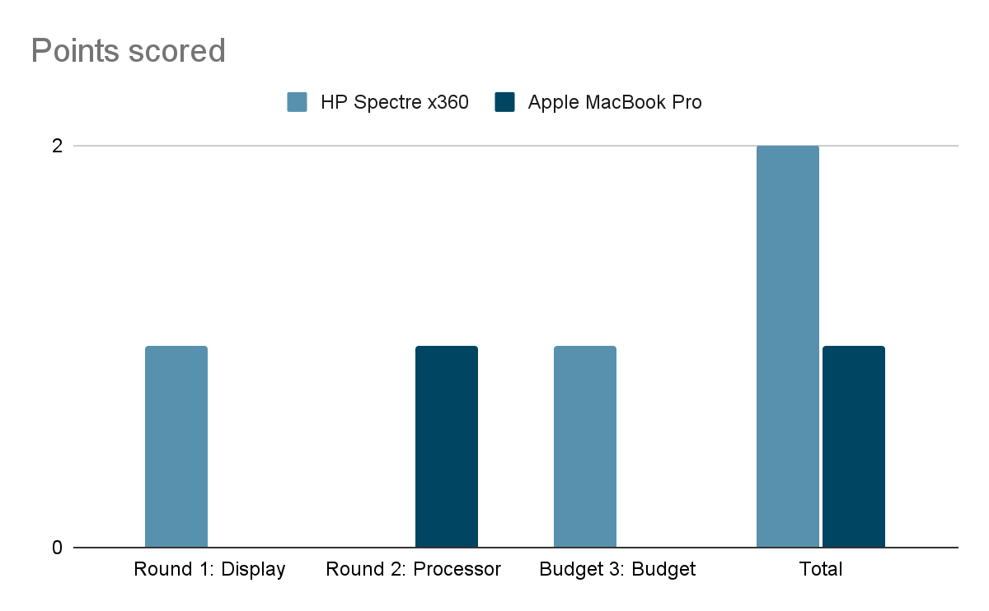
Conclusion
Winner: HP Spectre x360
Notes:
As you can see on the bar graph, HP scored 1 point in the first round. Apple managed to catch up in the second round, but HP gained another advantage in the third round.
<click next!!!>
As a result, HP Spectre x360 emerged as the winner.
That said, different programmers have different types of needs. Please consider the following recommendations in choosing your own laptops.

Slide 10

Recommendation
Determine your needs.
Rank you criteria.
Do your research.
Ask questions.
Notes:
First, determine your own needs. Some programmers value processors over budget, and some may not care about the budget at all. Each programmer can have unique needs so it’s important for you to recognize your must-haves and nice-to-haves.
Second, formulate your own criteria and rank them. You can even have different points for each criterion. Instead of treating each criterion equally, you can favor one over the other. For example, you can give a maximum of 5 points for your processor and maximum of 3 points for your display. It really boils down to what you need and prefer.
Next, do your research. Don’t just rely on online articles because everybody has their own biases. Some authors may have a preference for Apple products. Some articles may have been sponsored by laptop manufacturers.
Finally, ask questions. If your answers aren’t found online, you can go to the computer store and ask for advice directly from the sales personnel. You can even share with them your must-haves so they can help narrow down the choices for you. If you know people working in the industry, you can also ask for their advice.

Slide 11
References
[1] J. Wilkins, "freeCodecamp," 23 April 2021. [Online]. Available: https://www.freecodecamp.org/news/front-end-developer-what-is-front-end-development-explained-in-plain-english/. [Accessed 28 March 2022].
[2] N. Babich, "What are the Similarities & Differences Between UI Design and UX Design," Adobe, 4 October 2019. [Online]. Available: https://xd.adobe.com/ideas/process/ui-design/ui-vs-ux-design-understanding-similarities-and-differences/. [Accessed 28 March 2022].
[3] FlatIcon, "Flat Icon," Flat Icon, [Online]. Available: https://www.flaticon.com/free-icons/graphic-design. [Accessed 06 April 2022].
[4] D. Silveira, "What is a Pixel, Anyway?," Adobe Xd, 20 July 2021. [Online]. Available: https://xd.adobe.com/ideas/principles/web-design/what-is-a-pixel/. [Accessed 06 April 2022].
[5] Intel Inc., "What is Refresh Rate and Why is it Important?," Intel Inc., [Online]. Available: https://www.intel.com/content/www/us/en/gaming/resources/highest-refresh-rate-gaming.html#:~:text=The%20refresh%20rate%20of%20your,image%20144%20times%20per%20second.. [Accessed 06 April 2022].
[6] S. Harding, "What is a CPU Core? A Basic Definition," Future US Inc., 23 August 2018. [Online]. Available: https://www.tomshardware.com/news/cpu-core-definition,37658.html. [Accessed 06 April 2022].
[7] R. Hornby, "The Best Laptops for Programming in 2022," Future US Inc, 03 March 2022. [Online]. Available: https://www.laptopmag.com/best-picks/laptops-for-programming-2021. [Accessed 06 04 2022].
[8] A. Topper, "Best Laptop for Programming in 2022," BGFG UK, 01 February 2022. [Online]. Available: https://www.pcguide.com/laptop/guide/best-for-programming/. [Accessed 06 April 2022].
[9] M. Hanson and M. R. Uy, "Best Laptop for Programming in 2022," Future US Inc., 07 January 2022. [Online]. Available: https://www.techradar.com/news/best-laptop-for-programming. [Accessed 06 April 2022].
[10] Iintel, "RAM vs Processor," [Online]. Available: https://www.intel.ca/content/www/ca/en/business/small-business/resources/ram-vs-processor.html#:~:text=of%20the%20Processor-,The%20processor%2C%20also%20known%20as%20the%20CPU%2C%20provides%20the%20instructions,computer%20think%20and%20work%20faster.. [Accessed 28 March 2022].
[11] Apple Inc., "MacBook Pro (16-in, 2021) - Technical Specifications," 2021. [Online]. Available: https://support.apple.com/kb/SP858?locale=en_US. [Accessed 07 April 2022].
[12] HP Development Company, L.P., "HP Spectre x360 Convertible Laptop - 16t-f000," [Online]. Available: https://www.hp.com/us-en/shop/pdp/hp-spectre-x360-convertible-laptop-16t-f000-39r27av-1. [Accessed 07 April 2022].
[13] Algonquin College, “Mobile Device - School of Advanced Technology” Available: https://www.algonquincollege.com/byod/programs/school-of-advanced-technology/ [Accessed 07 April 2022].
Notes:
This is my list of references. If you have any question, please feel free to unmute yourselves or type it on the chat box.

